Slide 1
Assistant Executive Officer and
Senior Warrant Officer Advisor to the
40th Chief of Staff, Army
20 October 2022
CW5 Yolondria Dixon-Carter

Slide 2
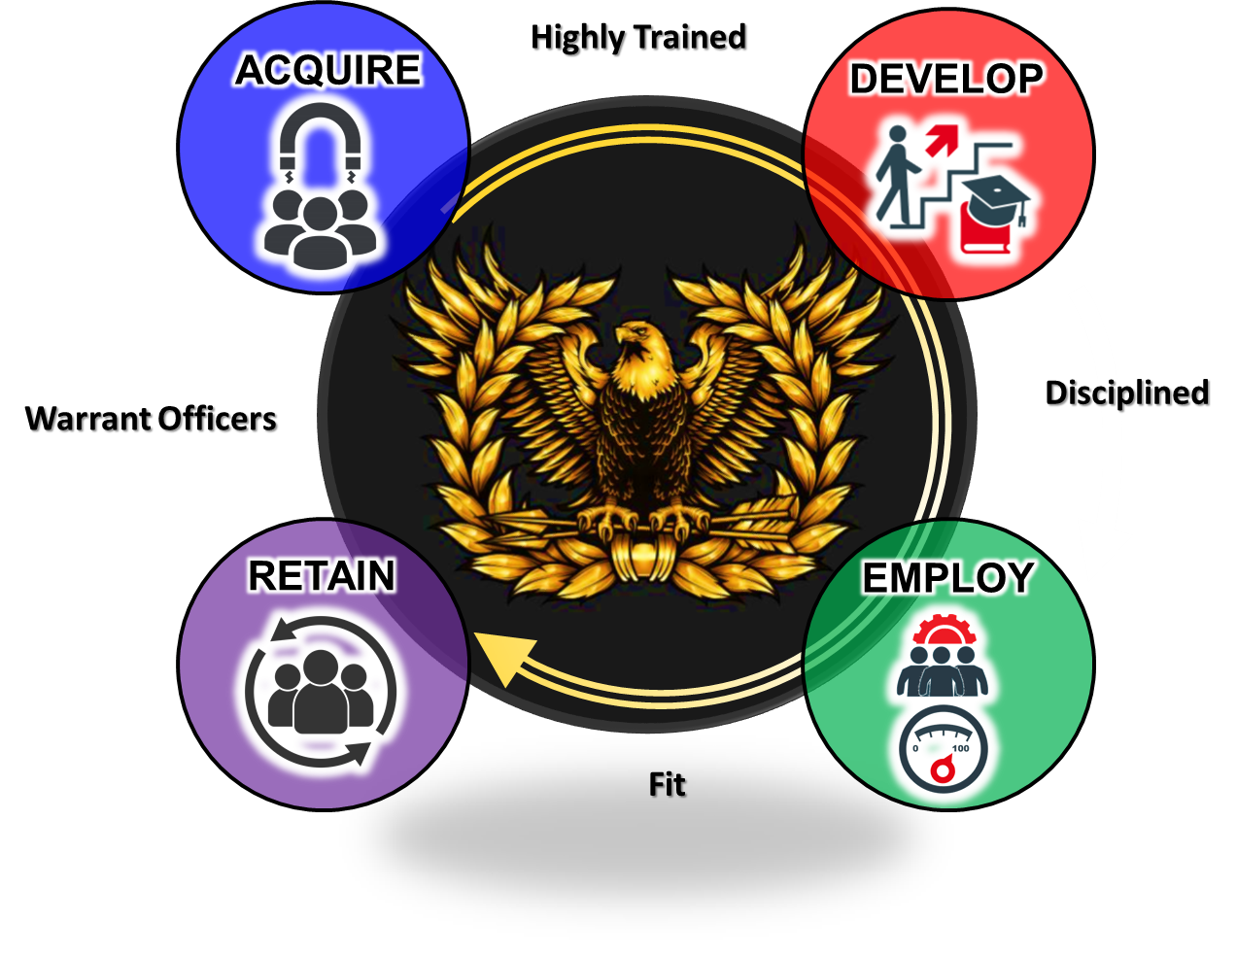
Warrant Officer Success Model

Slide 3
CSA 40 Call to service
We are in a WAR FOR TALENT. Winning will depend on changing how we recruit and retain good Soldiers.
The Army is PEOPLE, and our end strength = recruiting/retention.
Only 23% of young Americans are qualified to serve.
83% of new Soldiers come from military families.
Need Soldiers for Life (veterans and retirees) to HIRE and, most importantly, INSPIRE.
EVERYONE IS A RECRUITER/RETAINER!

Slide 4
INSPIRE TO SERVE
Chapter Leadership
Soldiers for Life
Chapter Members
Senior Warrant Officers
Notes:
Chapter leadership: Share the chapter accomplishments and work on multiple platforms; encourage membership in your respective areas; maintain chapter relevancy despite personnel changes
Chapter members: Come outside of the gated communities, do more than highway clean-up, work with local JROTC programs
Senior Warrant officers: maintain membership with local chapter, participate in events, encourage Warrant officers' membership and participation
Soldier for life: Maintaining membership after retire; continuing to be vocal and active in our communities; continue to advocate for expanded role of todays and tomorrow’s warrant officers; champion important initiatives as it relates to the Warrant Officer Cohort

Slide 5
People First
Winning Matters
Army Strong!
Notes:
Opportunity to take questions

